Slide 1
ECO-ASSIST
dOt cOm
Ahammed Shibinsha K.K
Adhil Rumais
Ankith P Vinod
Bassam Elachola

Slide 2
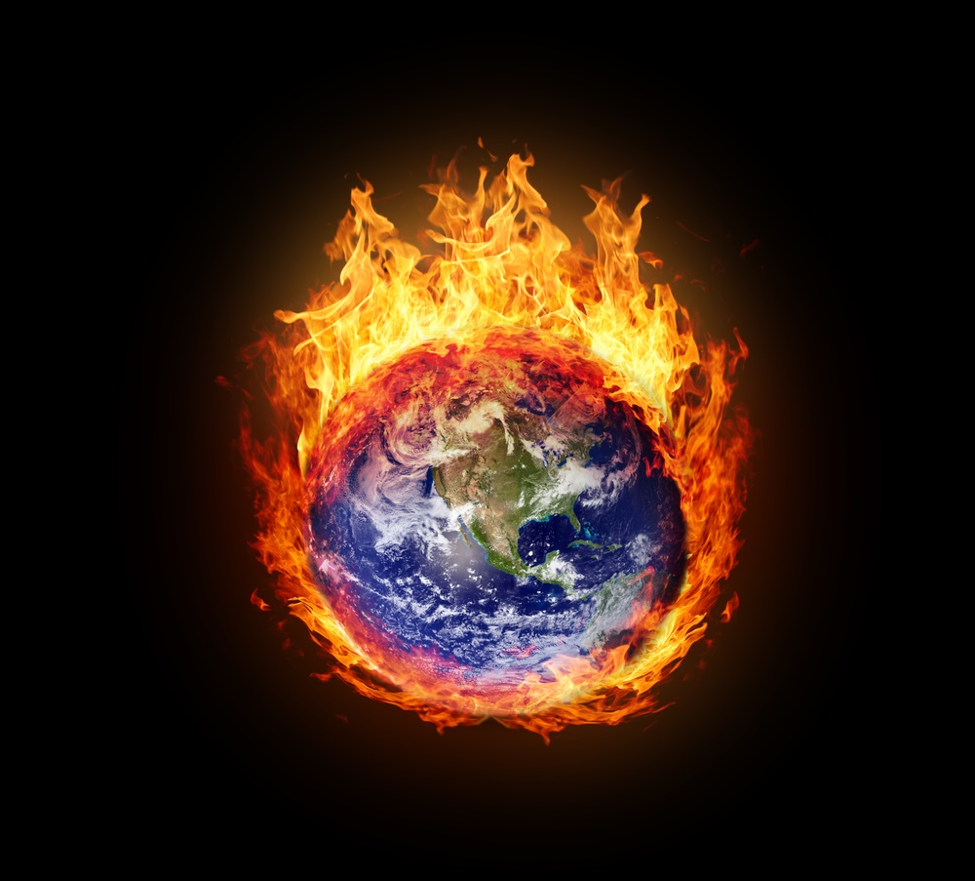
Due to rising concerns about the depletion of energy resources and effect of greenhouse gases in the atmosphere causing climate change leading to a global sustainable decline, we bring forward an innovation to promote usage of alternate energy sources and control the emission of greenhouse gases at household levels.

Slide 3
We present a reward-based system in which people are incentivized to perform tasks which contribute to sustainable development.
Tasks such as usage of public service systems are to be given points based on the frequency of use. People are not forced but encouraged to opt for public transport which minimizes any inefficient individual travel.
Usage of alternate sources of energy such as biogas plant, solar plants, harnessing wind energy personally etc. are given high priority and maximum points are assigned to the completion of such tasks.
In addition to this, minimizing the electricity usage in homes are also given consideration in our point system.

Slide 4
Usage of eco-friendly products are also promoted in our interface. Redeem codes are availed in certified products.
The points earned are exchanged for vouchers and gift cards.

Slide 5
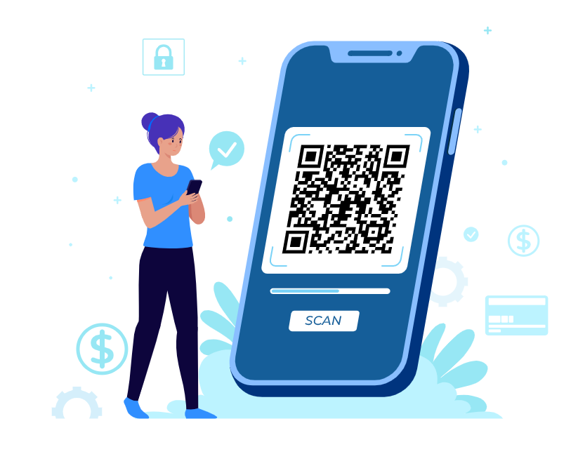
MODE OF EXECUTION
The system is implemented using QR scanners considering the feasibility.
QR scanners – Cheapest and most efficient
The ticket machines of buses are tweaked to introduce a one-time QR code on the bus ticket which can be scanned to add-on to our public transport count.

Slide 6
The alternate energy sources can be linked to the user’s individual eco-assist interface so that the energy generated can be updated at a specified interval to earn more coins.
Certified eco-friendly products are also given a redeem code inside the product to encourage the consumers’ preference towards these products rather than harmful ones.
Data pertaining to the electricity usage can also be linked to this interface to avail points if eligible, that is, if the usage is below the specified limit.

Slide 7
BUSINESS MODEL
Highly feasible – No installation of external devices required.
People earn incentives for the tasks they normally perform - get more interested.
Involves a competitive system wherein the weekly scores of friends are compared and displayed – more involvement.

Slide 8
To introduce the QR code tweak in buses, an introductory offer is to be provided to the bus owners which will benefit them.
Less fraudulent thoughts as sensitive information are not collected.
Companies are attracted as the vouchers provided is a considerable contribution to their advertising.
More companies might turn to eco-friendly materials to be entitled with the redeem codes to increase their sales.

Slide 9
PHASE – 2
An interface which analyses the carbon footprint and other emission data for each household.
The recommended carbon footprint level can be indicated by the app in comparison with the user’s footprint to generate and awareness.
The coins earned will be harshly restricted if the person exceeds the recommended levels.
Considering the future, we can replace the incentives and rewards by the NFT system, in which the users receive digital currencies and NFTs.

Slide 10
